Slide 1
Welcome to Aosdána
The affiliation of creative artists in Ireland
New Members Gathering
Arts Council Offices
13 June 2024

Slide 2
An Overview
Membership
General Assembly / Open Forum
Nominations and Election
Saoi
Toscaireacht
Cnuas
Administration
Special Projects

Slide 3
Membership
250 living artists who have produced a distinguished body of work.
Must have been resident in Ireland for 5 years and have produced a body of work that is original and creative.
Members are responsible for nominations and election of new members.
Members can be further recognised for outstanding achievement by the position of Saoi.
Members may apply for the Cnuas, which is multi-annual.
Members update their own biography and photo on the Aosdána web site.
Members contribute news of events/works for a weekly circular entitled ‘Dates for your Diaries’ , monthly Newsletter and Aosdána social media.
The Annual Artistic Report Form, open to all members to complete, is an additional way members can communicate about their work and thereby enable the Arts Council to acknowledge, celebrate and advocate for the work of Aosdána members and their impact on a wider public.

Slide 4
Current Membership June 2024

Slide 5
Current Membership June 2024

Slide 6
General Assembly / Open Forum
Each year the entire membership meets in a General Assembly to elect new members, agree matters of policy and procedure, review the activities of Aosdána and discuss issues relevant to the arts and artists in Society.
The General Assembly is regulated by Standing Orders and Chaired by the Toscaireacht. The Toscaireacht oversee approved Standing Orders.
It generally takes place over one day. This year the GA was in Dublin Castle on 26 March 2024.
The morning session is private with the afternoon open to the public.
In 2023 the membership devised an Open Forum in order to discuss issues of relevance and concern to the membership.
The first Open Forum was held in the Law Society at Blackhall Place on 21 Nov 2023.
Topics included EDI and the Future; Contribution and Engagement; Honour and Profile.
It is hoped that an Open Forum can take place each year in order to facilitate discussion and the formation of Standing Orders for the subsequent General Assembly Agenda.

Slide 7
Nominations and Election
Membership of Aosdána is by peer nomination and election.
Members have a responsibility to familiarise themselves with the work of candidates for election and to participate actively in all stages of the process.
Stage 1 – Any member can nominate an artist for membership. The call for nominations is in the Autumn and administered by the Registrar.
Stage 2 – Once nominations are complete and are approved by the Toscaireacht, as being according to rule, all members receive a ballot in their discipline by post or email. A candidate must achieve 50% + 1 of the quota to go forward to the General Assembly.
Stage 3 – All members receive information on candidates in advance of the General Assembly. A postal ballot can be arranged. Otherwise members cast their ballot on the day. The candidates with the greatest number of votes get elected in accordance with the number of spaces available up to the membership limit of 250.

Slide 8
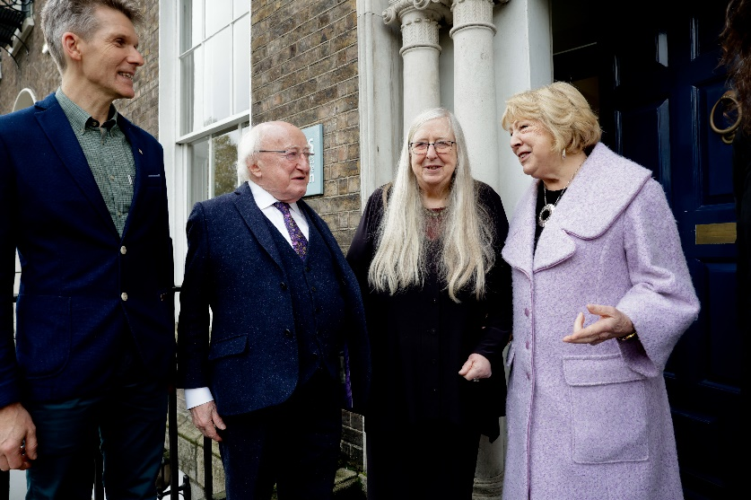
Saoithe
Any member can nominate another member for the honour of Saoi. A nomination must be assented to by 15 additional members. Election occurs by ballot of all members. To be elected a candidate must achieve 50% + 1 of the total membership.
No more than 7 members can hold the honour at any one time.
The President of Ireland confers the symbol of Saoi, the gold Torc.
There are currently 4 Saoithe. There are 3 vacancies
George Morrison, film-maker
Edna O’Brien, writer
Roger Doyle, composer
Eilean Ni Chuilleanain, writer
(most recent Saoi, elected 17 Nov 2022)

Slide 9
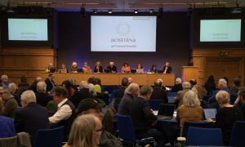
Toscaireacht
The Toscaireacht is a committee of 10 members (Toscairi) elected for a two year period. The election process for a new Toscaireacht is on-going and should be completed by end June 2024. The Toscaireacht meet 4 – 6 times a year. Meetings of the Toscaireacht are administered by the Registrar and all minutes of meetings are published on the Aosdána web site. www.aosdana.artscouncil.ie

Slide 10
Cnuas
The Cnuas is multi-annual and enables Aosdána members to concentrate their time and energy on the full-time pursuit of their art.
It is granted for a 5 year term (20 quarterly payments) to members who meet certain conditions.
Members apply for the Cnuas via an application form, available from the Registrar. Once a 5 year term comes to an end a member may re-apply.
Members in receipt of the Cnuas must complete an Annual Artistic Report Form and supply tax clearance confirmation and Revenue Form 11 each year in order to demonstrate ongoing eligibility. Members not in receipt of the Cnuas can also complete an Annual Artistic Report Form to communicate about their work however this is optional.
The Cnuas is currently set at €20,180 per annum and paid in 4 installments of €5,045. The income threshold is € 25,770.
Aosdána members in receipt of the Cnuas are not eligible to apply for other Arts Council Bursaries.
The Registrar administers the Cnuas and handles all details in relation to it. Names of members in receipt of the Cnuas are published on the Aosdána web site and in the Arts Council Annual Report.

Slide 11
Administration Special Projects
Aosdána was established in 1981.
See Aosdána Beginnings by Mark Duncan, commissioned to celebrate the 40th anniversary of Aosdana, for an in-dept outline of how Aosdána was established.
Aosdána is funded by the State through the Arts Council.
The Arts Council handles all of Aosdána’s administration and financial arrangements and reports on its operation to the Oireachtas.
Staff members of the Arts Council act as Registrar and Aosdána Assistant.
EDI Work Group Following on from the General Assembly March 2024 it was decided to form an EDI Work Group from the membership which would liaise with the Toscaireacht in relation to EDI.
Equality Questionnaire Following on from the General Assembly an EQ was issued to each member. An external researcher has been appointed to oversee the EQ.
Counter Culture research. CounterCulture will carry out an examination of international comparisons to Aosdana. This research is on-going and the report is due to be finalised before the end of Summer 2024.
Aosdána/Arts Council Working Group. 2 members of the Toscaireacht and the Arts Council Director and Registrar meet from time to time to discuss items of interest and initiatives. e.g. Through this the Open Forum was devised.
Aosdána Beginnings – It is envisaged that an e-book version of this publication will be produced in 2024 for wider circulation domestically and internationally.

